Slide 1
Three options for a capstone: putting the Brent in BCI

Slide 2
Three ideas within the world of Brain-Computer Interfaces (BCI)
Analyze existing open-source EEG data (electroencephalogram) to show I can work with EEG data
Request EEG or other BCI data from a company in the space and analyze that data
Build / buy my own EEG system and use it to detect sensory nerve activation in my own arm

Slide 3
1. Using open-source EEG data
Considerations | Detail
Problem Statement | Can I recreate the results of a published paper that uses EEG data to understand and interpret human thought or nerve stimulation?
Potential Audience | Potential employers in the BCI space
Goals | To show that I can work with BCI data and reproduce other people’s results
Success metric | Would need to use the same success metric / goal as the study for which the data was collected – e.g., can I recreate the accuracy of the researchers model to interpret imagined movement in the motor cortex?
Data source | There are a large number of open-source EEG datasets available online: https://sccn.ucsd.edu/~arno/fam2data/publicly_available_EEG_data.html
Other | Many (but not all) datasets are stored in matlab .mat files

Slide 4
2. Requesting BCI data from a company
Considerations | Detail
Problem Statement | Can I generate insights from an actual dataset from a BCI company?
Potential Audience | Potential employers in the BCI space
Goals | To show that I can work with cutting edge BCI data being used by an active startup
Success metric | Would need to use the same success metric / goal as the study for which the data was collected, since the data is already collected and the experiment run
Data source | Request datasets from Kernel, Neuralink, Batelle, Synchron, Paradromics, or another company
Other | Fairly unlikely that any company will give me data; if they do I likely will have to sign an NDA and won’t be able to publicly share the data or my results, but a great proof of concept for that particular company

Slide 5
3. Running my own experiment on detecting sensory nerve activation
Considerations | Detail
Problem Statement | Can I detect sensory nerve activation using cheap EEG sensors? This is interesting because nerves in the extremities of complete spinal cord injury patients are still alive, although disconnected from the central nervous system. Detecting the activation of those nerves is the first step in restoring sensation in those paralyzed parts of the body.
Potential Audience | Potential employers in the BCI space; public blog post
Goals | To show that I can set up and run an experiment using BCI data; and demonstrate thinking toward real-world solutions using BCI data
Success metric | Successfully creating a model that can predict when and what kind of touch occurred based only on EEG monitoring of sensory nerves
Data source | Would create it myself
Other | Requires purchase or DIY creation of EEG setup. Cheap out of the box system available for aprox. $500, could build a system from parts following other’s instructions for approximately $100 in 15-30 hours

Slide 6
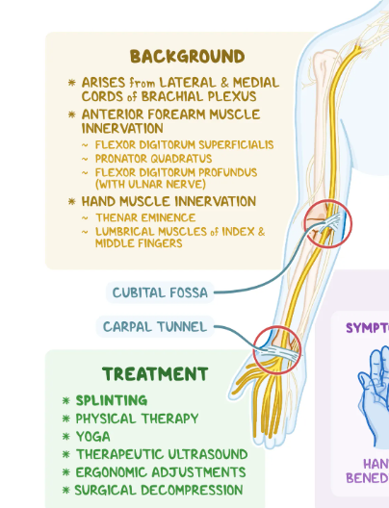
3. Details of running my own experiment
Based on literature search of other studies, likely best to monitor the median nerve in the arm given its proximity to the skin surface and confirmed detectability of sensory signals from other studies
Out of the box EEG amplifier available from OpenBCI for $400, requests out to several other companies for pricing
Cool DIY projects to use a headphone jack and the sound card of a laptop as the least expensive way to record EEG data – would require ordering ~$100 of parts and soldering them together to create the amplifier
Electrodes and conducting gel are both relatively inexpensive (less than $100 total)

